Slide 1
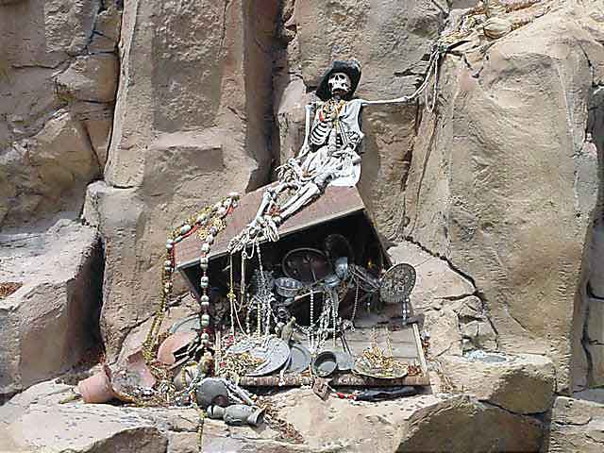
Forensic Anthropology Part II

Slide 2
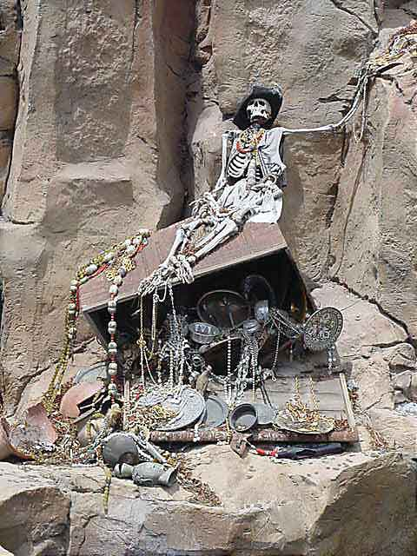
Forensic Anthropology
Anthropology/osteology
Odontology
Entomology
Botany

Slide 3
Forensic Anthropology
Hic locus est ubi mortui viveuntes docent.
This is the place where the dead teach the living.

Slide 4
Anthropology
A forensic anthropologist provides basic identification of skeletonized or badly decomposed remains.
From a whole bone or part of a bone, the scientist may be able to determine:
Age
Sex
Race
Height

Slide 5
How many bones are there in the human body?
206

Slide 6
Age Determination
Sutures:
Three major cranial sutures appear as distinct lines in youth and gradually close from the inside out.

Slide 7
Age Determination
Basilar Suture
Technically known as the synchondrosis spheno-occipitalis closes in females as young as 14 and in males as young as 16. If the suture is open, the individual is generally considered 18 or younger.

Slide 8
Gender Differences in Bones
The pelvis of the female is wider. Males have a narrow subpubic angle (A) and a narrow pubic bone body (B).

Slide 9
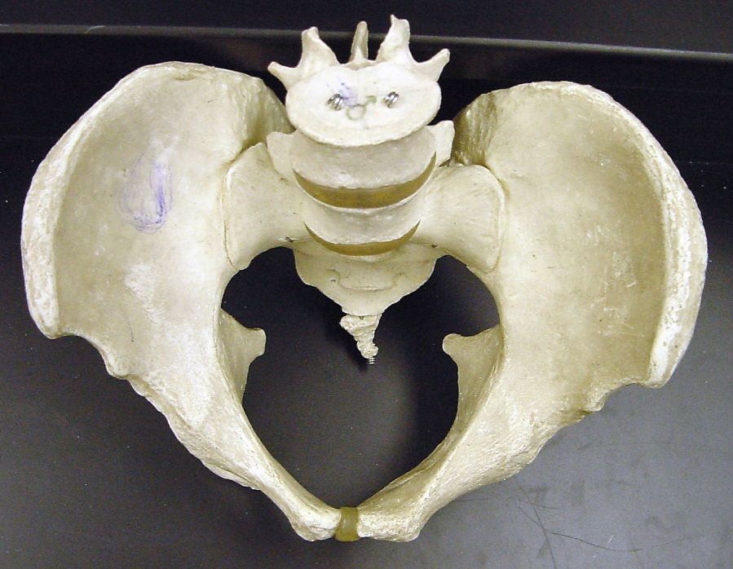
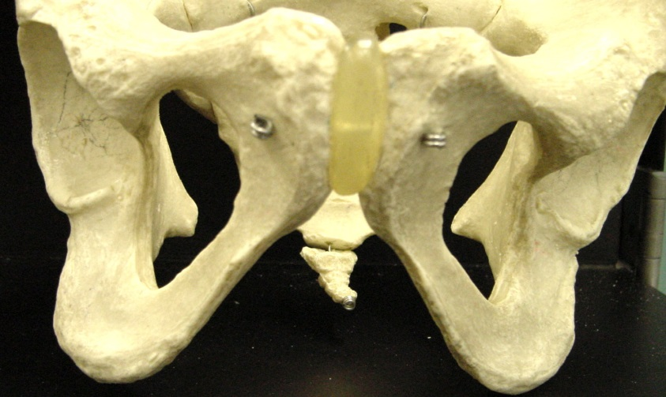
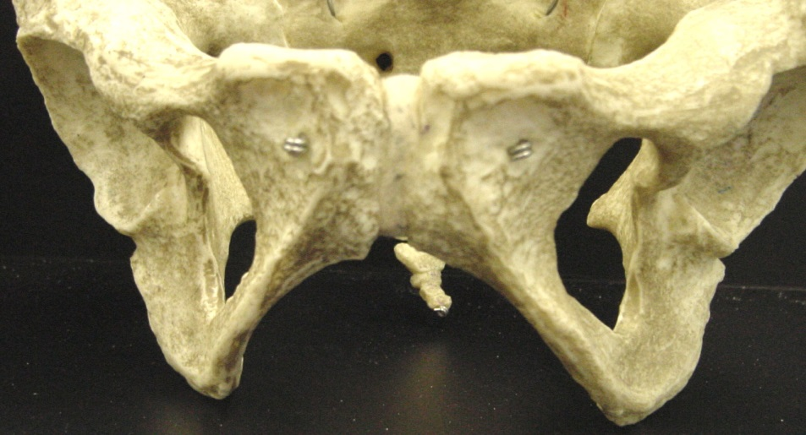
Male Female
Sub Pubic Angle

Slide 10
Gender Differences (cont)
The ribcage and shoulders of males are generally wider and larger than that of females. In addition, about one person in twenty has an extra rib. This is more common in males than in females. Most people have 12 pairs of ribs.

Slide 11
Gender Differences (cont)
Although occurring less consistently, with males the index finger is usually shorter than the third finger. In females, the first finger is longer than the third finger.
Is this a male or female hand
according to the above rule?

Slide 12
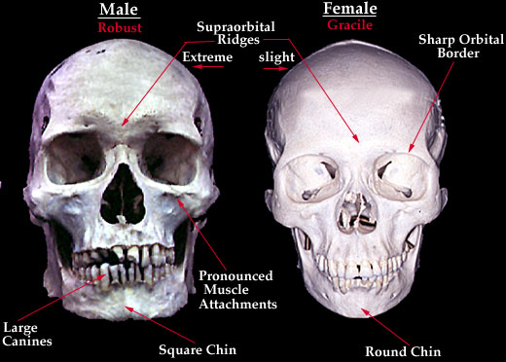
Gender Differences (cont)
Males have a sloping forehead while females have a straighter forehead

Slide 13
Gender Differences (cont)
Average bone weight
Male: 12 pounds
Female: 10 pounds

Slide 14
Human Stature
Height of a person can be calculated by using the length of certain bones, including the femur, tibia, humerus, and/or radius. Below are the average measurements for both male and female. There are more specific charts if you know the race of the individual. (All measurements are in centimeters)
Male Female
femur x 2.23 + 69.08 femur x 2.31 +61.41
tibia x 2.39 + 81.68 tibia x 2.53 + 72.57
humerus x 2.97 + 73.57 humerus x 3.14 + 64.97
radius x 3.65 + 80.40 radius x 3.87 + 76.50

Slide 15
Race
Race is difficult to determine from most skeletal remains, especially since there are no pure races. An experienced forensic anthropologist can generally place skulls into one of four groups:
Caucasian
African American
Asian (Mongoloid)
American Indian

Slide 16
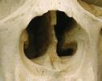
Race (just a few examples)
African ancestry: more flared nasal opening
Asian ancestry: zygomatic arch (or cheek bone) more angled forward giving the person a slightly more flattened face
African Male Nose (Note Flaring)
Asian Male Cheek (Note how it is angled forward)

Slide 17
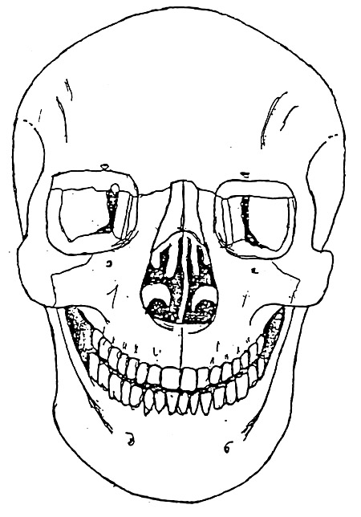
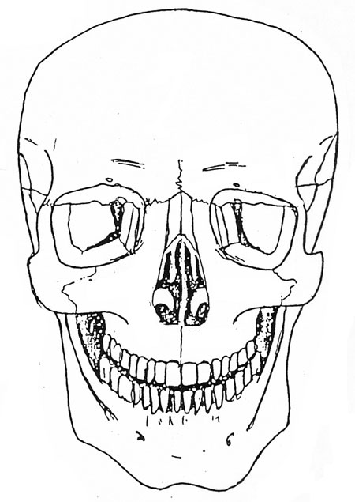
Racial Differences What differences do you notice between these three skulls? Could you tell each race?
Asian
African
European

Slide 18
Homework Questions
Define forensic anthropology.
What information can be determined from skeletal remains?
How can we tell if the bones belong to an adolescent or an adult?
How do bones differ between genders?
How do bones differ between races?

