Slide 1
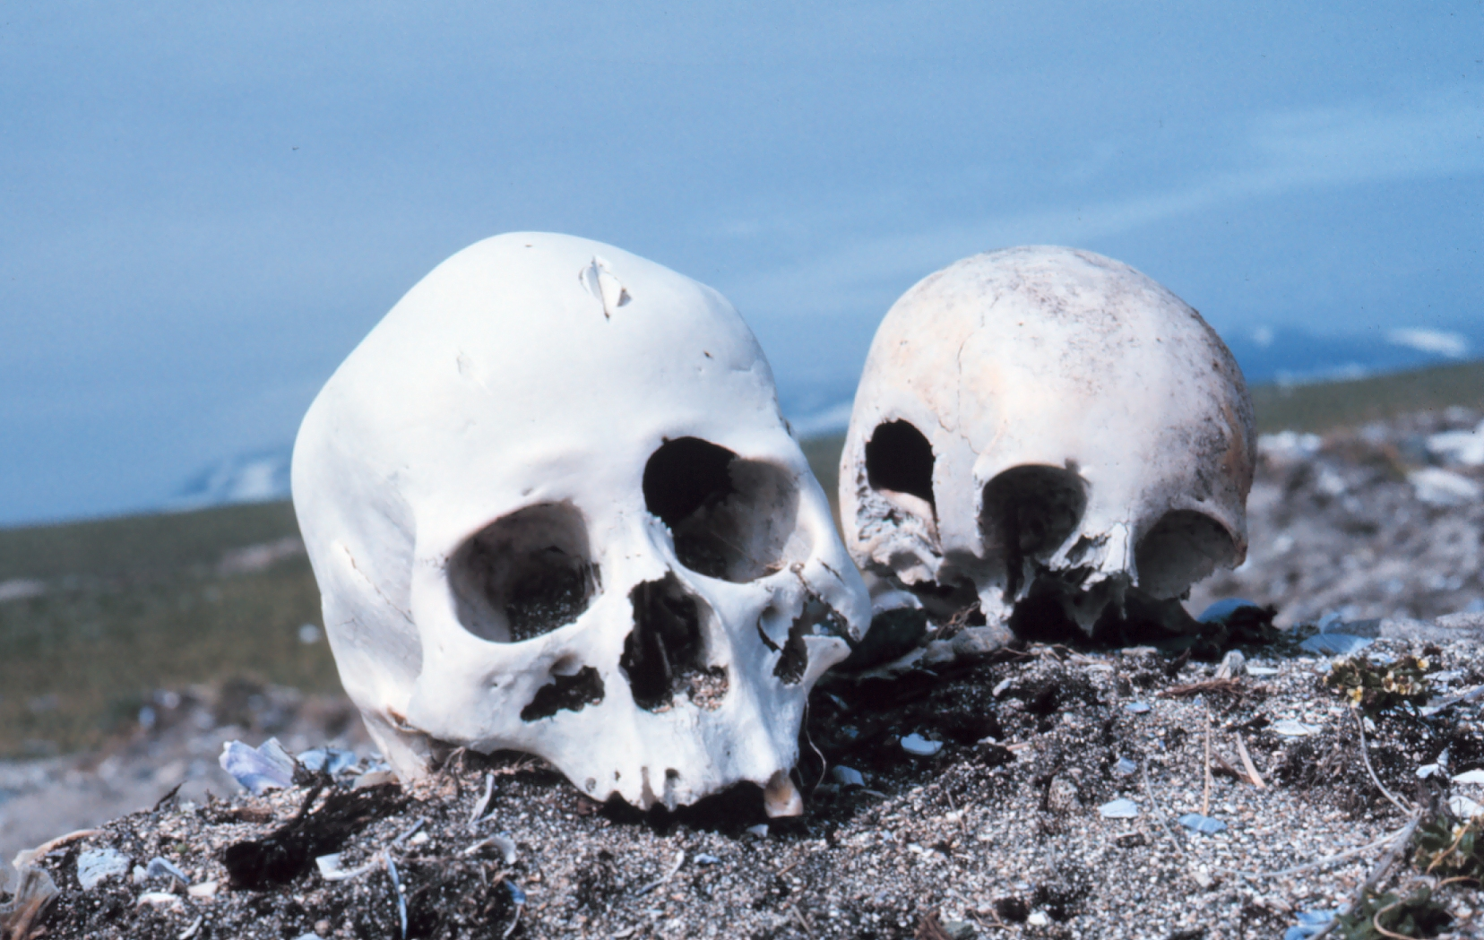
Forensic Anthropology
Let the bones tell the story!
Image: http://upload.wikimedia.org/wikipedia/commons/4/4c/Punuk.Alaska.skulls.jpg
Presentation originally developed by T. Trimpe 2010 http://sciencespot.net

Slide 2
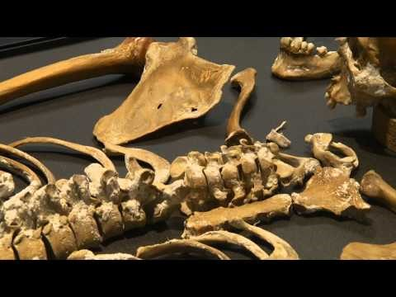
Power of the Bones

Slide 3

What role do anthropologists play in solving crimes?
Watch the video and then answer the questions.
http://www.youtube.com/watch?v=H-lso0JL3Z8
What does a physical anthropologist investigate?
What four things do we want to know about a skeleton?
What bones are most useful for developing a profile of a person? Explain how they are used.

Slide 4
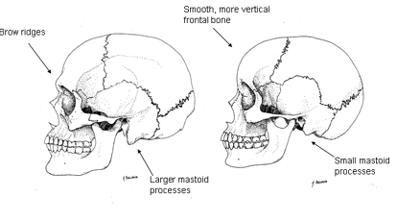
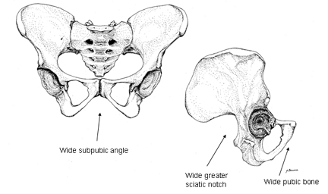
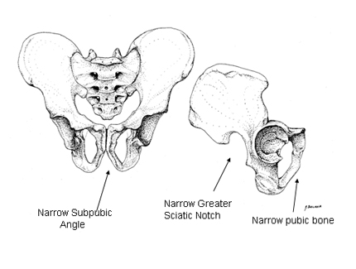
FORENSIC ANTHROPOLOGISTS analyze skeletal remains to determine the identity of a victim as well as his/her life history, cause of death, or other clues about a crime.
Main Characteristics:
 Sex - Determined by examining the skull, pelvis, humerus, and femur
Age and stature (height/build) – Determined by analyzing the development of the teeth, bone growth, cranial suture lines, and the length of specific bones, such as the femur.
 Race – Determined by analyzing the skull for characteristics that are common among people of different races.
Which skull would belong to a female?
Which pelvis would belong to a female?
Source: http://www.crime-scene-investigator.net/excavation.html
Images: http://www.wadsworth.com/anthropology_d/special_features/forensics/forensics_index/index.html

Slide 5
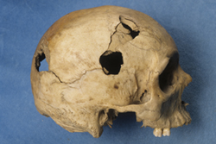
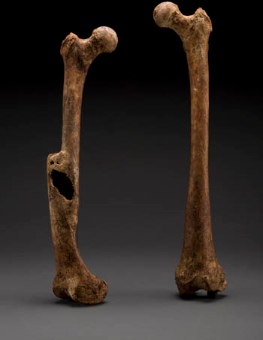
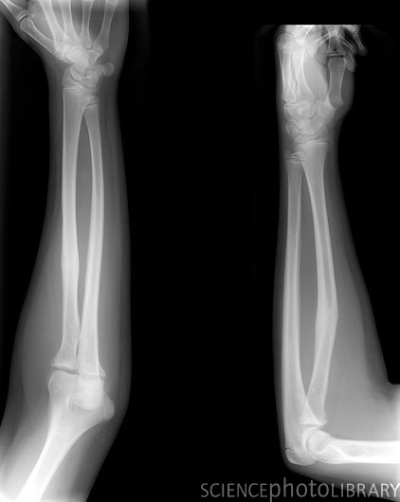
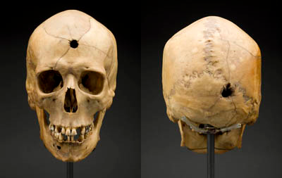
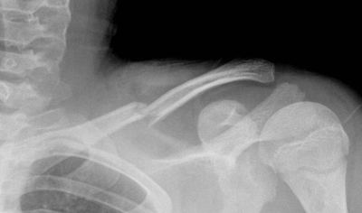
What else can we learn from bones?
DNA samples can be collected from bone, teeth, and hair to provide clues to a person’s identity.
Scientists may also be able to gain clues as to a person’s past, recent injuries, or the cause of death based on bone fractures and other signs of trauma.
Damage from a hammer
Healed Fractures
Gunshot Wounds
Images: http://www.legacyhealth.org/images/Housecalls/claviclefx.jpg, http://www.sciencephoto.com/images/download_lo_res.html?id=773301768, http://anthropology.si.edu/writteninbone/calvert_femur.html, http://anthropology.si.edu/writteninbone/trauma.html

Slide 6
Forensic Tools & Techniques
Watch the video and then answer the questions.
https://youtu.be/EJXtai8uUeM?list=PLtBm5nBSx_S_ZYnGLDmvUi5d9JCKRrure
What techniques or tools did the scientists use to find the body?
What is “disturbed soil”? What might it indicate?
How did they narrow down the areas to investigate?

Slide 7
Reading the Remains
Watch the video and then answer the questions.
https://www.youtube.com/watch?v=kGriERmU8Dc
What information do they provide for law enforcement agencies?
How many skeletons do they have in their collection?
What do they learn about a skeleton from each tool?
CT Scan –
X- ray –
Mass spectrometer –
Scanning electron microscope –
DNA Analysis –

Slide 8
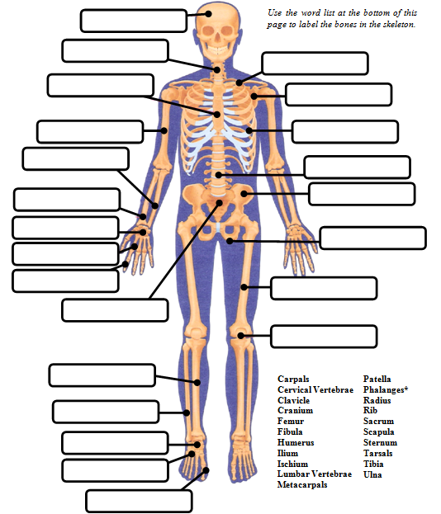

Cranium
Directions:
Identify the bones in the skeleton. One label will be used twice!
Cervical Vertebrae
Clavicle
Sternum
Scapula
Humerus
Ribs
Ulna
Lumbar Vertebrae
Radius
Ilium
Carpals
Ischium
Metacarpals
Phalanges
Femur
Sacrum
Patella
Tibia
Fibula
The Bone Dance
Tarsals
Metatarsals
Phalanges

Slide 9
Quick Quiz – Give the common name for each bone.
I should have known it was going to be one of those days, when I had stepped out of bed and stubbed my (1) PHALANGE on the night stand. While hopping up and down on one (2) METATARSAL and grasping the other, I slipped and fell onto my right shoulder breaking my (3) CLAVICLE. As I crawled on my
(4) METACARPALS and (5) PATELLAS to my bed, I felt my (6) CRANIUM begin to ache. I found my phone and let my (7) PHALANGES do the walking as I called my friend to come help me out. My friend answered the phone with a loud scream; my (8) MANDIBLE dropped, I asked what had happened, and he replied that he had been startled by the ringing phone, fell out of bed landed on his (9) COCCYX. Following that while racing to the phone he hit his (10) TIBIA on a stool. I should have known it was going to be one of those days. Like when Russell Westbrook broke his (11) ZYGOMATIC ARCH, or if you slipped on ice and broke your (12) CARPAL.
TOE
2. FOOT
3. COLLAR BONE
4. HANDS
5. KNEES
6. SKULL or HEAD
7. FINGERS
8. LOWER JAW
9. TAIL BONE
10. SHIN
11. CHEEK
12. WRIST
Source: http://www.homepage.montana.edu/~mtpbs/Education/NTTILessonPlans2/LegBoneConnectedToThe/NTTILegBoneConnectedToThe.pdf

Slide 10
Directions:
Identify the bones in the skeleton. One label will be used twice!
The Bone Dance

