Slide 1
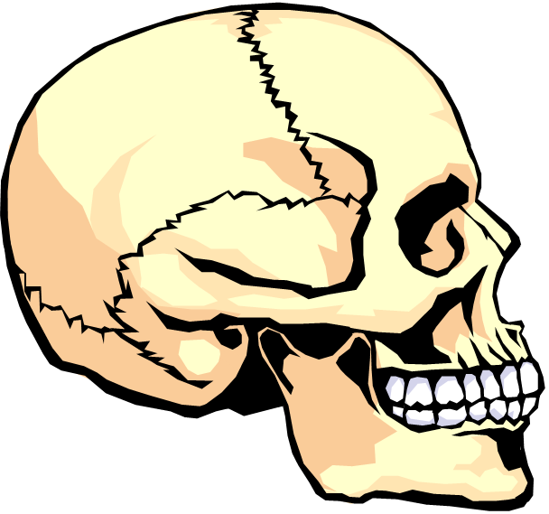
Forensic Odontology

Slide 2
What is Forensic Odontology?
Forensic Odontology is a branch of forensic medicine which, in the interest of justice, deals with the proper examination, handling and presentation of dental evidence in a court of law.

Slide 3
What is Forensic Odontology?
Forensic Odontologists will often work with forensic pathologists and forensic anthropologists.

Slide 4
So…What can an Odontologist discover?
ID of bite marks on a victim
Comparison of bite marks with the teeth of a suspect and presentation of this evidence in court as an expert witness
ID of bite marks on other substances such as wood, leather and foodstuffs
ID of unknown bodies through dental records
Age estimations of skeletal remains

Slide 5
The physical characteristics of both the bite mark wound and the suspect’s teeth include:
The distance from cuspid to cuspid
The shape of the mouth arch
The evidence of a tooth out of alignment
Teeth width and thickness, spacing between teeth
Missing teeth
The curves of biting edges
Unique dentistry
Wear patterns such as chips or grinding

Slide 6
How reliable are bite marks in connecting a suspect with a crime?
Answer: Horrible!!!
Why? Soft tissue will swell or distort and…
two people can have similar teeth
construction.
However… bite marks can exclude suspects.

Slide 7
How helpful are teeth in identifying human remains?
Answer: Excellent!!!
Teeth remain very intact even through violent crimes, fires, accidents and advanced decomposition. DNA is also preserved very well in the pulp of a tooth.

Slide 8
Teeth Diagram & Chart
incisors - the front teeth, used for cutting food. An incisor has 1 root. Adults have 8 incisors (4 in the top jaw and 4 in the bottom jaw).
canine (also called cuspid) - the pointy tooth located between the incisors and the premolars. A canine tooth has 1 root. Adults have 4 canine teeth (2 in the top jaw and 2 in the bottom jaw). Canine means, "of or like a dog."

Slide 9
Teeth Diagram & Chart
premolars (also called bicuspids) - the teeth located between the canine and the molars. A premolar tooth has 1 root. Bicuspids have two points (cusps) at the top. Adults have 8 premolars (4 in the top jaw and 4 in the bottom jaw).
molars - the relatively flat teeth located towards the back of the mouth, used for grinding food. Molars in the top jaw have 3 roots; molars in the lower jaw have 2 roots. Adults have 12 molars (6 in the top jaw and 6 in the bottom jaw).

Slide 10
Homework Questions
What is forensic odontology?
What other scientists often work with an forensic odontologist?
Give 2 examples of information they can discover.
Why aren’t teeth marks reliable evidence?
How are teeth helpful for forensic investigations?
What is the name of the front row of teeth?
How many teeth do most adults have?
Explain how you would differentiate and identify one tooth from another…

