Slide 1
Forensic Odontology

Slide 2
What is Forensic Odontology?
Forensic Odontology is a branch of forensic medicine which, in the interest of justice, deals with the proper examination, handling and presentation of dental evidence in a court of law.

Slide 3
What is Forensic Odontology?
Forensic Odontologists will often work with forensic pathologists and forensic anthropologists, and even entomologists.

Slide 4
So…What can an Odontologist discover?
ID of bite marks on a victim
Comparison of bite marks with the teeth of a suspect and presentation of this evidence in court as an expert witness
ID of bite marks on other substances such as wood, leather and foodstuffs
ID of unknown bodies through dental records
Age estimations of skeletal remains

Slide 5
The physical characteristics of both the bite mark wound and the suspect’s teeth include:
The distance from cuspid to cuspid
The shape of the mouth arch
The evidence of a tooth out of alignment
Teeth width and thickness, spacing between teeth
Missing teeth
The curves of biting edges
Unique dentistry
Wear patterns such as chips or grinding

Slide 6
How reliable are bite marks in connecting a suspect with a crime?
Answer: Horrible!!!
Why? Soft tissue will swell or distort and…
two people can have similar teeth
construction.
However… bite marks can exclude suspects.

Slide 7
How helpful are teeth in identifying human remains?
Answer: Excellent!!!
Teeth remain very intact even through violent crimes, fires, accidents and advanced decomposition. DNA is also preserved very well in the pulp of a tooth.

Slide 8
Teeth Diagram & Chart
incisors - the front teeth, used for cutting food. An incisor has 1 root. Adults have 8 incisors (4 in the top jaw and 4 in the bottom jaw).
canine (also called cuspid) - the pointy tooth located between the incisors and the premolars. A canine tooth has 1 root. Adults have 4 canine teeth (2 in the top jaw and 2 in the bottom jaw). Canine means, "of or like a dog."

Slide 9
Teeth Diagram & Chart
premolars (also called bicuspids) - the teeth located between the canine and the molars. A premolar tooth has 1-2 roots. Bicuspids have two points (cusps) at the top. Adults have 8 premolars (4 in the top jaw and 4 in the bottom jaw).
molars - the relatively flat teeth located towards the back of the mouth, used for grinding food. Molars in the top jaw have 3 roots; molars in the lower jaw have 2 roots. Adults have 12 molars (6 in the top jaw and 6 in the bottom jaw). 3-5 cusps.

Slide 12
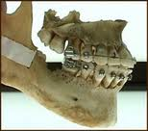
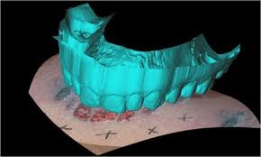
Dental Identification and Lip Prints
Original from: Mr. Syswerda

Slide 13
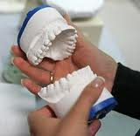
Forensic Dentistry
Forensic Dentistry involves the evaluation of dental evidence with the intent of assisting the administration of justice.
It is more accurately called Forensic Odontology.

Slide 14
What Forensic Odontologists Do.
Another source lists these as the primary responsibilities of Forensic Odontologists (add to your previous list):
Identification of human dental remains.
Identification in mass fatalities.
Cases of child/domestic abuse.
Assessing injuries involving bite marks.
Assessing malpractice in civil cases.
Age estimation

Slide 15
Identifying Human Remains
Human teeth are highly unique; some experts say teeth are equally unique to fingerprints.
Teeth are also very tough due to the high mineral levels they contain; they may survive circumstances that would destroy other tissues used for identification.
Ante-mortem and post-mortem records can be compared to establish positive ID.

Slide 16
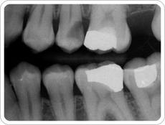
Identifying Human Remains (cont.)
Based on the following details, Forensic Odontologists are able to identify otherwise highly decomposed human remains:
1. Fillings
2. Extractions
3. Surface and root patterns
4. Adjacent teeth
5. Angle of teeth relative to other teeth.

Slide 17
Mass Fatalities
In some instances there are disasters in which many people lose their lives simultaneously and the remains are highly damaged (i.e. WTC 9/11).
Forensic odontologists may be able to match surviving teeth to existing dental records. Remember, teeth can survive much greater trauma than most body tissues.
These dental remains can then be returned to their respective families for burial.

Slide 18
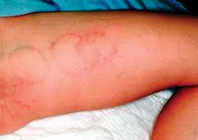
Child/Domestic Abuse
Sadly, many instances of child and domestic abuse involve biting.
By analyzing the marks left behind, forensic odontologists are often able to determine a culprit and even their intent (based on the severity of the injury).

Slide 19
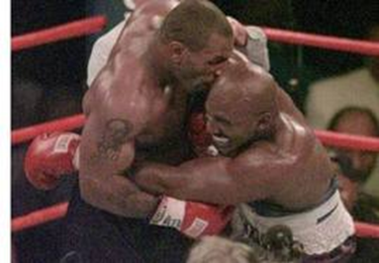
Assessing Injuries Involving Bite Marks

Slide 20
Types of Bite Marks
The following is a list of the seven types of bite marks recognized by most forensic odontologists:
1. abrasion – minor mark on skin
2. contusion – bruising on skin
3. hemorrhage -- small break in skin
4. incision -- clean puncture of skin
5. laceration -- punctured or torn skin
6. avulsion -- removal of skin
7. artifact – piece of body has been removed

Slide 21
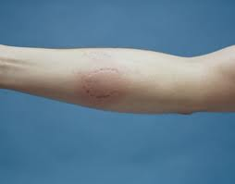
Severity of Bite Marks
The following four items represent the common levels of severity observed with bite marks:
1. clearly defined -- observable pressure
2. obviously defined -- significant pressure
3. quite noticeable -- violent pressure
4. lacerated -- skin violently torn from body

Slide 22
Malpractice
Occasionally, forensic odontologists may be called upon to assess the teeth of an individual who believes their dentist or orthodontist has made a mistake in treating or failing to treat a dental ailment.
These proceedings usually are determined in a civil court.

Slide 23
Estimating age
Forensic Odontologists are also asked to help estimate the age of unknown individuals based on several factors:
Number of teeth in their mouth:
Children have 20 “baby” teeth though often not all at once. (8 incisors, 4 canines, 8 molars)
Adults have 32 teeth including wisdom teeth, the removal of which would bring that number to 28. (8 incisors, 4 canines, 8 pre-molars, 12 molars.)

Slide 24
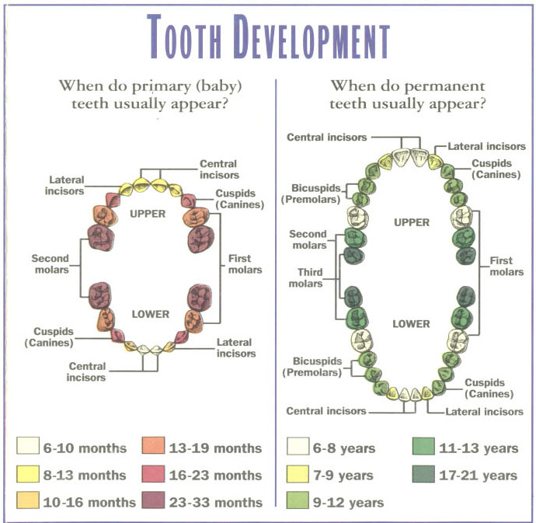
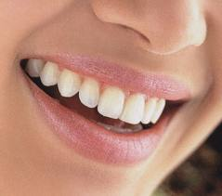
Estimating Age (cont.)
Additionally, forensic odontologists can use the following information to estimate age:
Condition of tooth enamel.
Condition of tooth root.
Tooth decay.

Slide 25
Estimating Age (cont.)

Slide 26
Lip Prints
Lip Prints are used less frequently than other methods of identification.
Lip prints are believed to be unique, though limited testing has been done to substantiate this claim.
Genetics & environment play a role in lip structure.
Lip prints are a lesser known method for identification; criminals don’t disguise them as regularly.

Slide 27
Homework Questions
What is forensic odontology?
What other scientists often work with an forensic odontologist?
Give 2 examples of information they can discover.
Why aren’t teeth marks reliable evidence?
How are teeth helpful for forensic investigations?
What is the name of the front row of teeth?
How many teeth do most adults have?
Explain how you would differentiate and identify one tooth from another…

