Slide 1
Forensic Odontology Part II

Slide 2
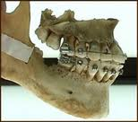
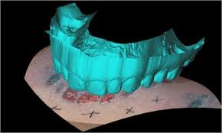
Dental Identification and Lip Prints
Original from: Mr. Syswerda

Slide 3
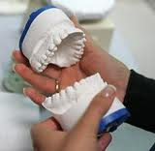
Forensic Dentistry
Forensic Dentistry involves the evaluation of dental evidence with the intent of assisting the administration of justice.
It is more accurately called Forensic Odontology.

Slide 4
What Forensic Odontologists Do.
There are six primary responsibilities of Forensic Odontologists:
Identification of human dental remains.
Identification in mass fatalities.
Cases of child/domestic abuse.
Assessing injuries involving bite marks.
Assessing malpractice in civil cases.
Age estimation

Slide 5
Identifying Human Remains
Human teeth are highly unique; some experts say teeth are equally unique to fingerprints.
Teeth are also very tough due to the high mineral levels they contain; they may survive circumstances that would destroy other tissues used for identification.
Ante-mortem and post-mortem records can be compared to establish positive ID.

Slide 6
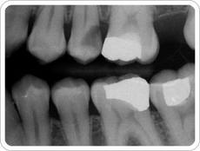
Identifying Human Remains (cont.)
Based on the following details, Forensic Odontologists are able to identify otherwise highly decomposed human remains:
1. Fillings
2. Extractions
3. Surface and root patterns
4. Adjacent teeth
5. Angle of teeth relative to other teeth.

Slide 7
Mass Fatalities
In some instances there are disasters in which many people lose their lives simultaneously and the remains are highly damaged (i.e. WTC 9/11).
Forensic odontologists may be able to match surviving teeth to existing dental records. Remember, teeth can survive much greater trauma than most body tissues.
These dental remains can then be returned to their respective families for burial.

Slide 8
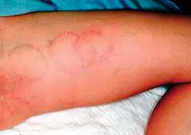
Child/Domestic Abuse
Sadly, many instances of child and domestic abuse involve biting.
By analyzing the marks left behind, forensic odontologists are often able to determine a culprit and even their intent (based on the severity of the injury).

Slide 9
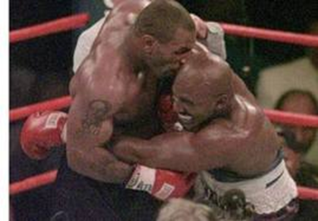
Assessing Injuries Involving Bite Marks
The methods of this role are largely similar to assessing cases of abuse.
There are two lists that can be used to identify bite marks and grade their severity respectfully.

Slide 10
Assessing Injuries Involving Bite Marks

Slide 11
Types of Bite Marks
The following is a list of the seven types of bite marks recognized by most forensic odontologists:
1. abrasion – minor mark on skin
2. contusion – bruising on skin
3. hemorrhage -- small break in skin
4. incision -- clean puncture of skin
5. laceration -- punctured or torn skin
6. avulsion -- removal of skin
7. artifact – piece of body has been removed

Slide 12
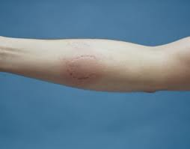
Severity of Bite Marks
The following four items represent the common levels of severity observed with bite marks:
1. clearly defined -- observable pressure
2. obviously defined -- significant pressure
3. quite noticeable -- violent pressure
4. lacerated -- skin violently torn from body

Slide 13
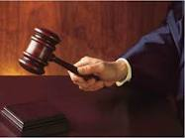
Malpractice
Occasionally, forensic odontologists may be called upon to assess the teeth of an individual who believes their dentist or orthodontist has made a mistake in treating or failing to treat a dental ailment.
These proceedings usually are determined in a civil court.

Slide 14
Estimating age
Forensic Odontologists are also asked to help estimate the age of unknown individuals based on several factors:
Number of teeth in their mouth:
Children have 20 “baby” teeth though often not all at once. (8 incisors, 4 canines, 8 molars)
Adults have 32 teeth including wisdom teeth, the removal of which would bring that number to 28. (8 incisors, 4 canines, 8 pre-molars, 12 molars.)

Slide 15
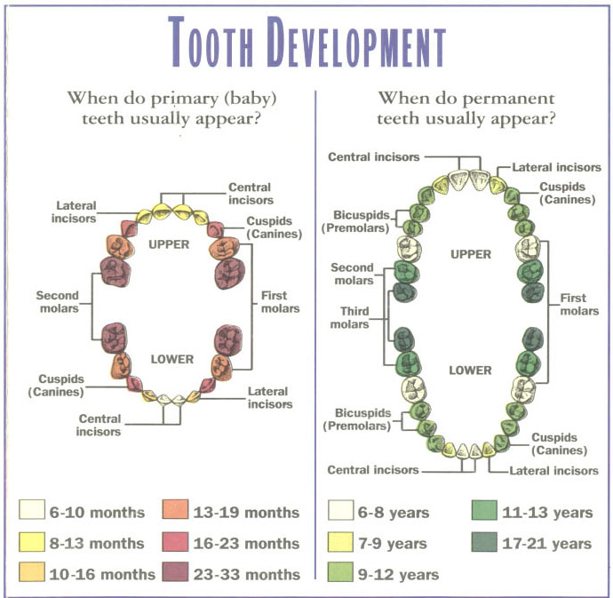
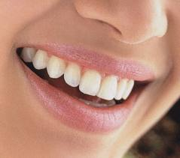
Estimating Age (cont.)
Additionally, forensic odontologists can use the following information to estimate age:
Condition of tooth enamel.
Condition of tooth root.
Tooth decay.

Slide 16
Estimating Age (cont.)

Slide 17
Lip Prints
Lip Prints are used less frequently than other methods of identification.
Lip prints are believed to be unique, though limited testing has been done to substantiate this claim.
Genetics & environment play a role in lip structure.
Lip prints are a lesser known method for identification; criminals don’t disguise them as regularly.

