Slide 1
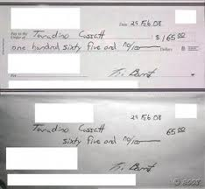
Forgery, Fraud & Handwriting Analysis
Originally from: Mr. Syswerda

Slide 2
Forgery
Forgery is the ACTION of altering or producing an object or information with the INTENT of deception.
Forgery often includes:
Signatures (on a check or other official document.)
Money (usually called counterfeiting.)
Artwork
Trademarked items such as clothing or purses.

Slide 3
Forgery and the Law
Simply creating a copy of an object, like a movie prop, does not constitute forgery.
An individual or group must also attempt to deceive and (usually) profit from their forgery.
Counterfeiting carries a fine of up to 15 years in federal prison.
The sentences of other forgery crimes vary by state and the extent of the deception.

Slide 4
Counterfeit Currency

Slide 5
Counterfeit Currency

Slide 6
Forgery and the Law (cont.)
Forgery is often part of a larger crime called Fraud.
Fraud is the crime of deceiving an individual or group for the purpose of unlawful gain or profit.
Common crimes of fraud include:
Falsifying documents or figures.
Inappropriate usage of funds.
Lying to an entity to gain something.

Slide 7
Handwriting Analysis
There are typically two types of handwriting analysis. The first is called Graphology.
Graphology is an imprecise science where so-called handwriting “experts” analyze someone’s handwriting and attempt to make generalized statements about the individual. (Such as, “This person is very organized”.)

Slide 8
Graphology (*not a Science, but has some value)

Slide 9
Handwriting Analysis (cont.)
Graphology is not very reliable but in a criminal investigation, any details may be valuable.
Withholding a right or a privilege from someone based on graphology is a dangerous legal practice because graphology is NOT always accurate.

Slide 10
Handwriting Analysis (cont.)
The second type of handwriting analysis is used to determine if a particular sample is forged or genuine (valid).
Usually when individuals attempt to forge a sample, they will often attempt to copy the handwriting style of the person they’re imitating.
They will have the person’s sample placed right next to the document they’re signing.

Slide 11
QD & QDE
Questioned Document
QD = ___________ __________
QDE = ___________ __________ Examiner
Questioned Document

Slide 12
Is a Sample Forged? (cont.)
This practice tends to lead to several tell-tale signs:
1. The overall look of the sample is “odd”.
2. There are ink-blots where the pen was left in one spot.
3. There are breaks in the sample where the pen was lifted.
4. The length of the sample is different.
5. The letters may appear to have a “tremor” to them.

Slide 13
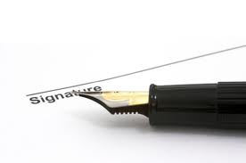
Handwriting Analysis (cont.)
In addition to the shapes of letters, Questioned Documents Examiners (QDEs) look for:
Spacing between letters, words and lines.
Grammar, punctuation and word choice.
Evidence of unique writing instruments.

Slide 14
Forgery and Technology
Technology has added a new frontier to forgery crimes.
Criminals can “cut and paste” signatures and account numbers digitally.
Sometimes these forgeries are difficult to detect but when attempted they may leave telltale marks like slight color variations around the border of the signature.

Slide 15
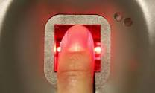
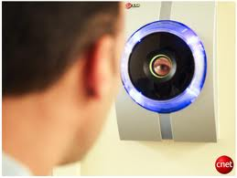
Avoiding Forgery
As technology improves, many new methods have evolved to make forgery more difficult.
Biometric identification such has fingerprints and eye or voice recognition make forgery more difficult.
A low-tech way to avoid forgery is to match identification to anyone signing a document.

