Slide 1
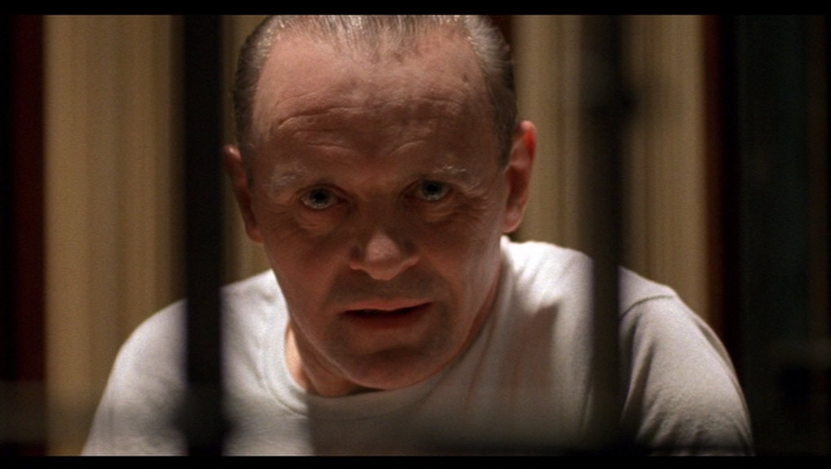
Serial Crime
Original From: Mr. Syswerda

Slide 2
Introduction
Serial crime is defined as crime of a repetitive nature.
Serial crime is often marked by similar techniques used during the commission of the crime as well as similar targets.
The most common serial crimes are murder, rape and arson.
Almost all serial criminals create a positive psychological stimulus by committing their crimes.

Slide 3
“Cooling Off” Period
One of the most common characteristics of serial crime is a “cooling off” period between incidents.
Each time a serial criminal strikes they satisfy their psychological desire.
They lay dormant for a period of time (days, weeks, years) as their desire grows and then they strike again.

Slide 4
Serial Killers
Many crime research institutes define a Serial Killer as an individual who commits two or more murders on separate occasions to attain psychological gratification.
Other common aspects of serial killings include:
-a “cooling off” period between killings.
-similarities in victims or in methods of
assault.

Slide 5
Characteristics of Serial Killers
The following is a general list of characteristics of serial killers:
Above average to high IQ.
Abused/tortured animals or other kids as a child.
Unstable home life/absent father.
Obsession with starting fires.
Bed wetting beyond age 12.
Socially stable but hold jobs with low public regard.
Abused as children.
White, male under age 40.

Slide 6
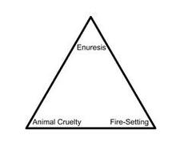
Psychopathological Triad

Slide 7
Psychopathological Triad
Bed-Wetting – enuresis
There’s nothing unusual or alarming about bed-wetting in itself; it’s a common phenomenon among little children. When the problem persists into puberty, however, it may well be a sign of significant and even dangerous emotional disturbance. According to the findings of the FBI’s Behavioral Science Unit, fully 60 percent of sex-murderers were still suffering from this condition as adolescents.

Slide 8
Psychopathological Triad
Fire-Starting – pyromania
Given their lust for destruction, it’s no surprise that, among their other twisted pleasures, many serial killers love to set fires, a practice they often begin at an early age. Some of the most notorious serial killers of modern times were juvenile arsonists.

Slide 9
Psychopathological Triad
Fire-Starting – pyromania
David Berkowitz- who ultimately confessed to more than fourteen hundred acts of arson-was so obsessed with fires as a little boy that his schoolmates nicknamed him “Pyro.” He is more commonly known as the “Son of Sam”.

Slide 10
Psychopathological Triad
Animal Torture – precocious sadism
Juvenile sadism directed at lower life-forms is another component of the triad, which involves abuse and/or torture merely for pleasure.

Slide 11
Serial Killers Vs. Mass Murderers
Serial Killers and Mass Murderers are often confused.
Mass murderers are different from serial killers because they usually commit their crimes over a much shorter time frame.
Also, they usually are not selective with their victims.
Mass murderers often commit suicide following their crimes.

Slide 12
Serial Arson
Serial Arson is the repetitive, intentional lighting of fires which damage property.
Many serial arsonists are pyromaniacs who derive psychological pleasure from seeing the destructive effects of fire.
Serial Arsonists may or may not know the owner of the property they destroy.
Serial Arsonists usually do NOT intend to kill or harm anyone when they set fires.

Slide 13
Serial Arson Motivation
The motivation for a Serial Arsonist may include:
Retaliation for perceived persecution by a individual, group or society in general.
Desire to feel important; the arsonist often feels as though they are unnoticed by society.
Uncontrollable desire to witness the damaging effects of fire.
Attempt to cover up another crime by destroying the crime scene.
Attempt to defraud insurance for financial gain.

Slide 14
Serial Arson Characteristics
White, Male; almost half are under age 27
Average to above average intelligence but has difficulty in a formal educational setting.
Difficultly fitting in with society.
History of mental illness and drug use.
Have a physical disability, birth mark/defect or have small stature.
Over half come from homes where both parents were present.

Slide 15
Serial Rapists
Serial Rapists strike two or more victims with a “cooling off” period between incidents.
While clearly a sexual crime, rape is usually not motivated by sexual desire.
A serial rapist is more often motivated by unresolved anger or a desire to feel powerful.
Serial rapists often meticulously observe, plan and execute their assaults using similar methods on similar victims.

Slide 16
Characteristics of Serial Rapists
Almost all male.
Delusions of grandeur; feel they don’t get the recognition they deserve from society.
About 1/3 suffer from some sexual dysfunction.
Usually do not take precautions to conceal their identities.
Report low levels of sexual gratification from their crimes.

